Slide 1
Nuclear Physics: An Engineering Perspective
Part II

Slide 2
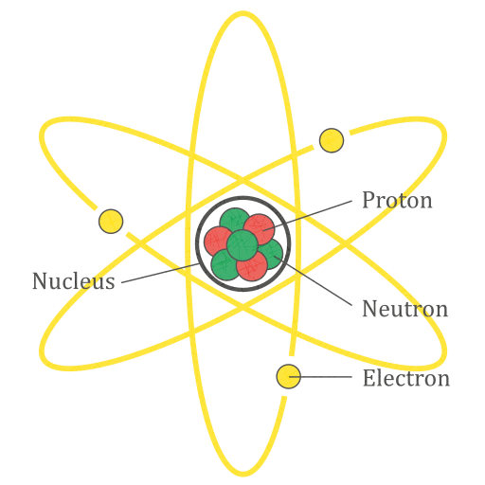
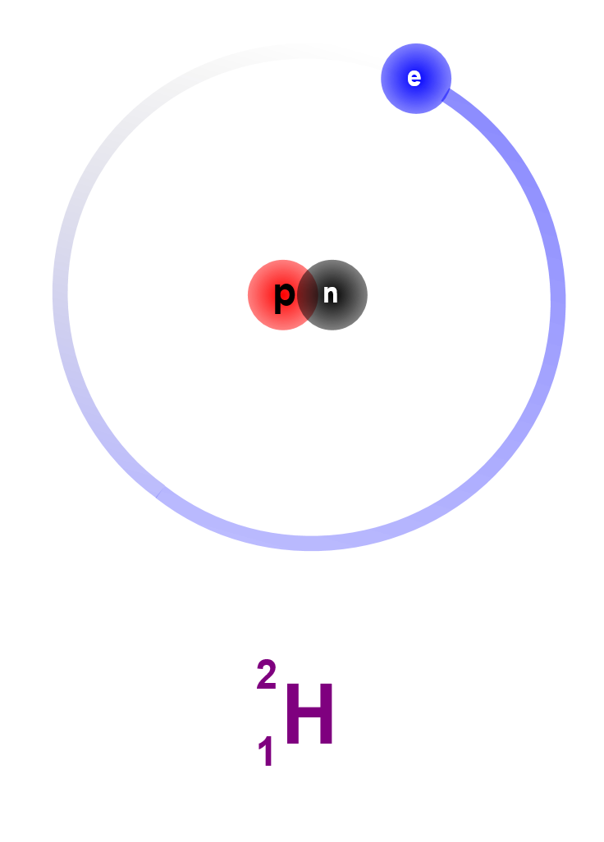
Review: Atomic Structure
# of protons determines element
# of neutrons determines isotope
Mass Number (Z+N)
https://commons.wikimedia.org/wiki/File:Atom_Diagram.svg CC BY-SA 4.0 AG Caesar
Protons (Z)
Element

Slide 3
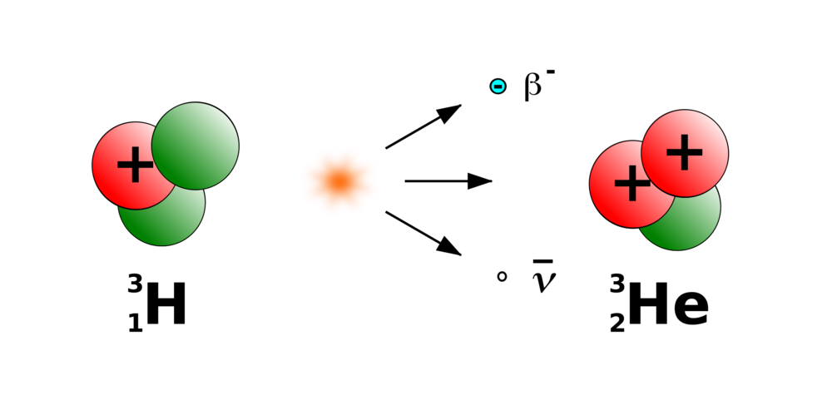

Review: β Decay
Some isotopes are unstable, that is, they decay into other isotopes
${}_{1}^{3}H\overset{→}{}{}_{2}^{3}{He}+e^{−}+\overline{{\text{ν}}_{e}}$
A neutron turns into a proton, releasing a beta particle (electron)
Also an electron antineutrino ($\overline{ν_{e}}$), but that’s less important for nuclear physics
https://www.pinclipart.com/pindetail/hhJTom_tritium-radioactive-decay-beta-decay-beta-particle-beta/

Slide 4
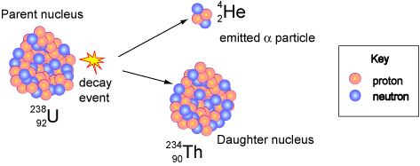

α Decay
Mostly occurs in large atoms
E.g., Polonium-210, Americium-241
2 protons & 2 neutrons break off as an alpha particle
Element number -2, mass number -4
α particle = ${}_{2}^{4}{He}$ nucleus
https://www.atnf.csiro.au/outreach/education/senior/cosmicengine/sun_nuclear.html&sa

Slide 5
γ Radiation
Not a particle like α and β
Electromagnetic radiation
Like light, radio, etc.
Doesn’t transmute nucleus
Basically a way for atoms to get rid of extra energy
When atoms undergo decay, the products can end up in excited states (too much energy)
They can get rid of this energy by emitting γ rays (get to ground state)

Slide 6
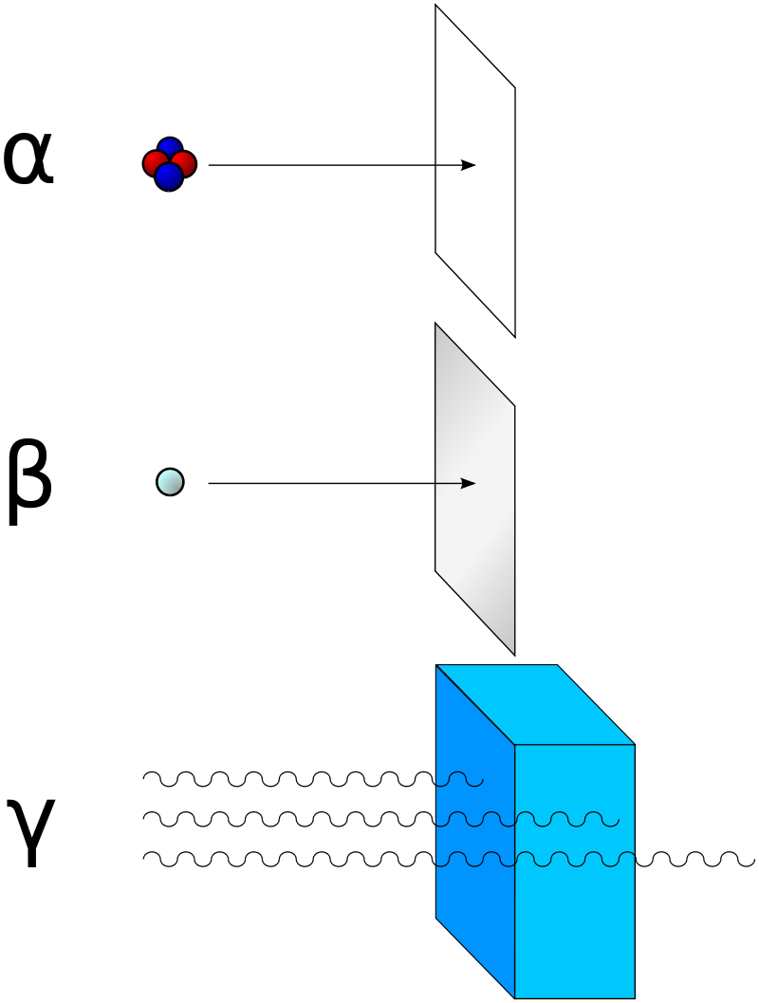
Radiation Penetration
https://commons.wikimedia.org/wiki/File:Alfa_beta_gamma_radiation.svg
CC BY-SA 3.0
Stannered

Slide 7
Half Life
Start
64
64/2=32
Round 1
32
32
Round 2
32/2=16
16
48
16/2=8
Round 3
8
56
8/2=4
Round 4

Slide 8
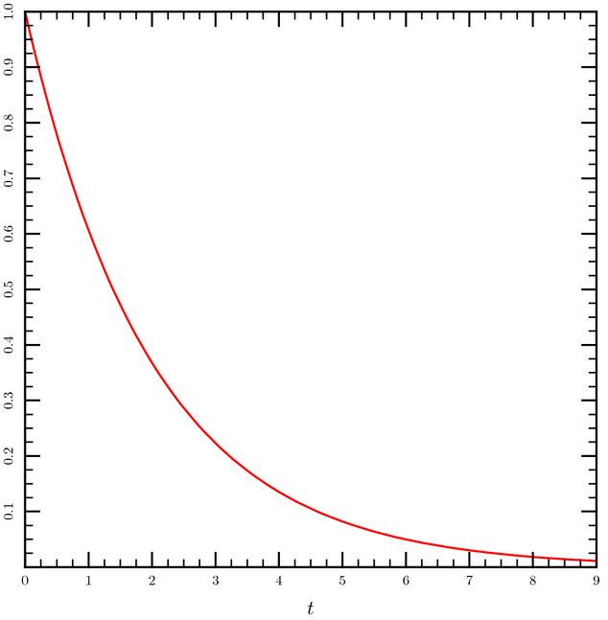

Half Life
Half life = the time it takes for half the atoms to decay
$N\left(t\right)= N_{0}⋅{\left(0.5\right)}^{\frac{t}{t_{1/2}}}$
($t_{1/2}$ is the half-life)

Slide 9

Half Life
Decay rate, or activity, is measured in Curies (Ci)
1 Curie is $3.7⋅{10}^{10}$ decays per second
Note that the activity is the rate-of-change of atoms
And therefore the derivative of the exponential decay function

Slide 10

Half Life
For example, ${}_{27}^{60}{Co}$ has a half-life of 5.27 years
If you start with a mole of ${}_{27}^{60}{Co}$, after 5.27 years, you will have 0.5 mol of ${}_{27}^{60}{Co}$ and 0.5 mol of (stable) ${}_{28}^{60}{Ni}$
The activity will also drop by half

Slide 11
Decay Schemes
Okay, we know about different kinds of decay, and how fast it happens (half-life).
How do specific isotopes decay into others?

Slide 12
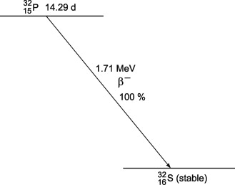
Decay Schemes
Initial isotope
Half-life
Decay mode
Energy
Decay type
% of atoms that take this route
Stable isotope(s)

Slide 13
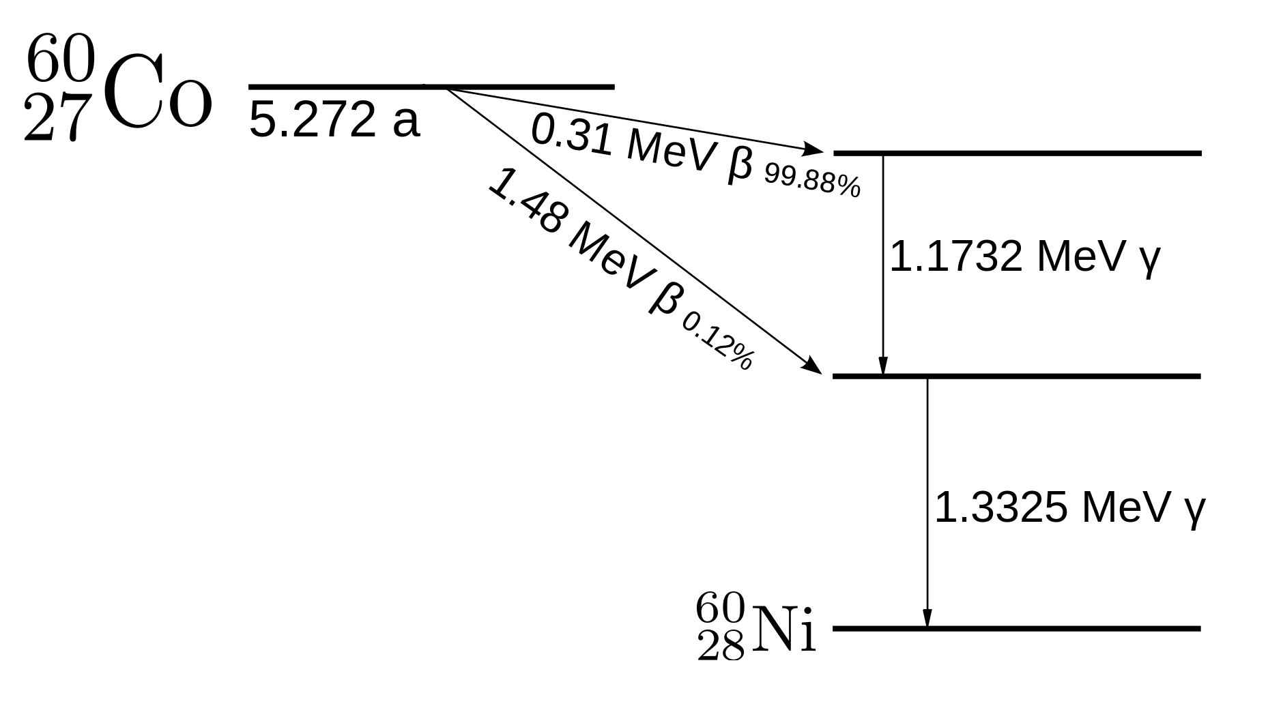
Decay Schemes
https://www.nuclear-power.net/wp-content/uploads/2019/02/cobalt-60-decay-scheme.png

Slide 14
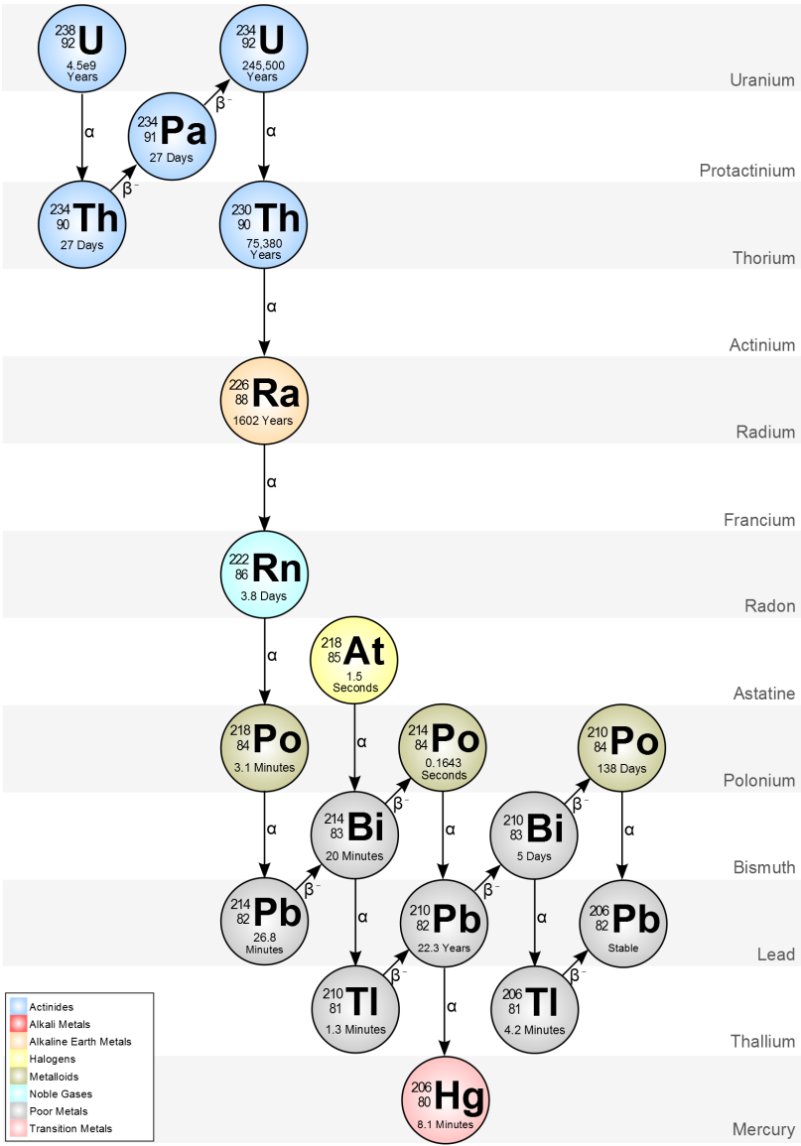
Decay Schemes
https://commons.wikimedia.org/wiki/File:Decay_Chain_of_Actinium.svg CC BY-SA 3.0 Edgar Bonet

Slide 15
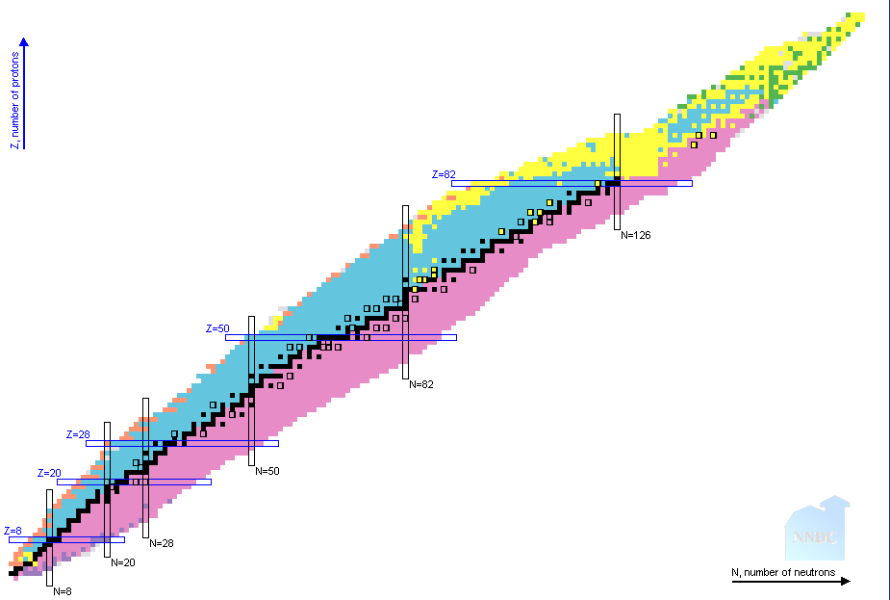

Table of Nuclides
(Nuclide is basically a synonym for isotope)

Slide 16
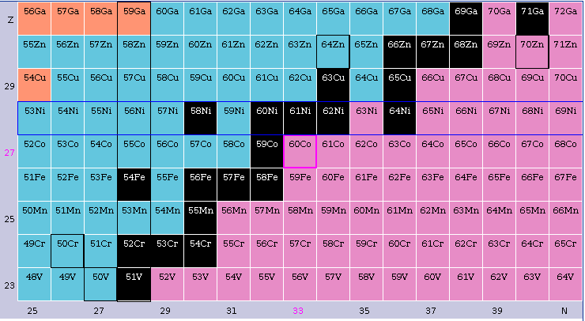
Table of Nuclides
https://www.nndc.bnl.gov/nudat2/index.jsp

